Slide 1


Slide 2


Slide 3
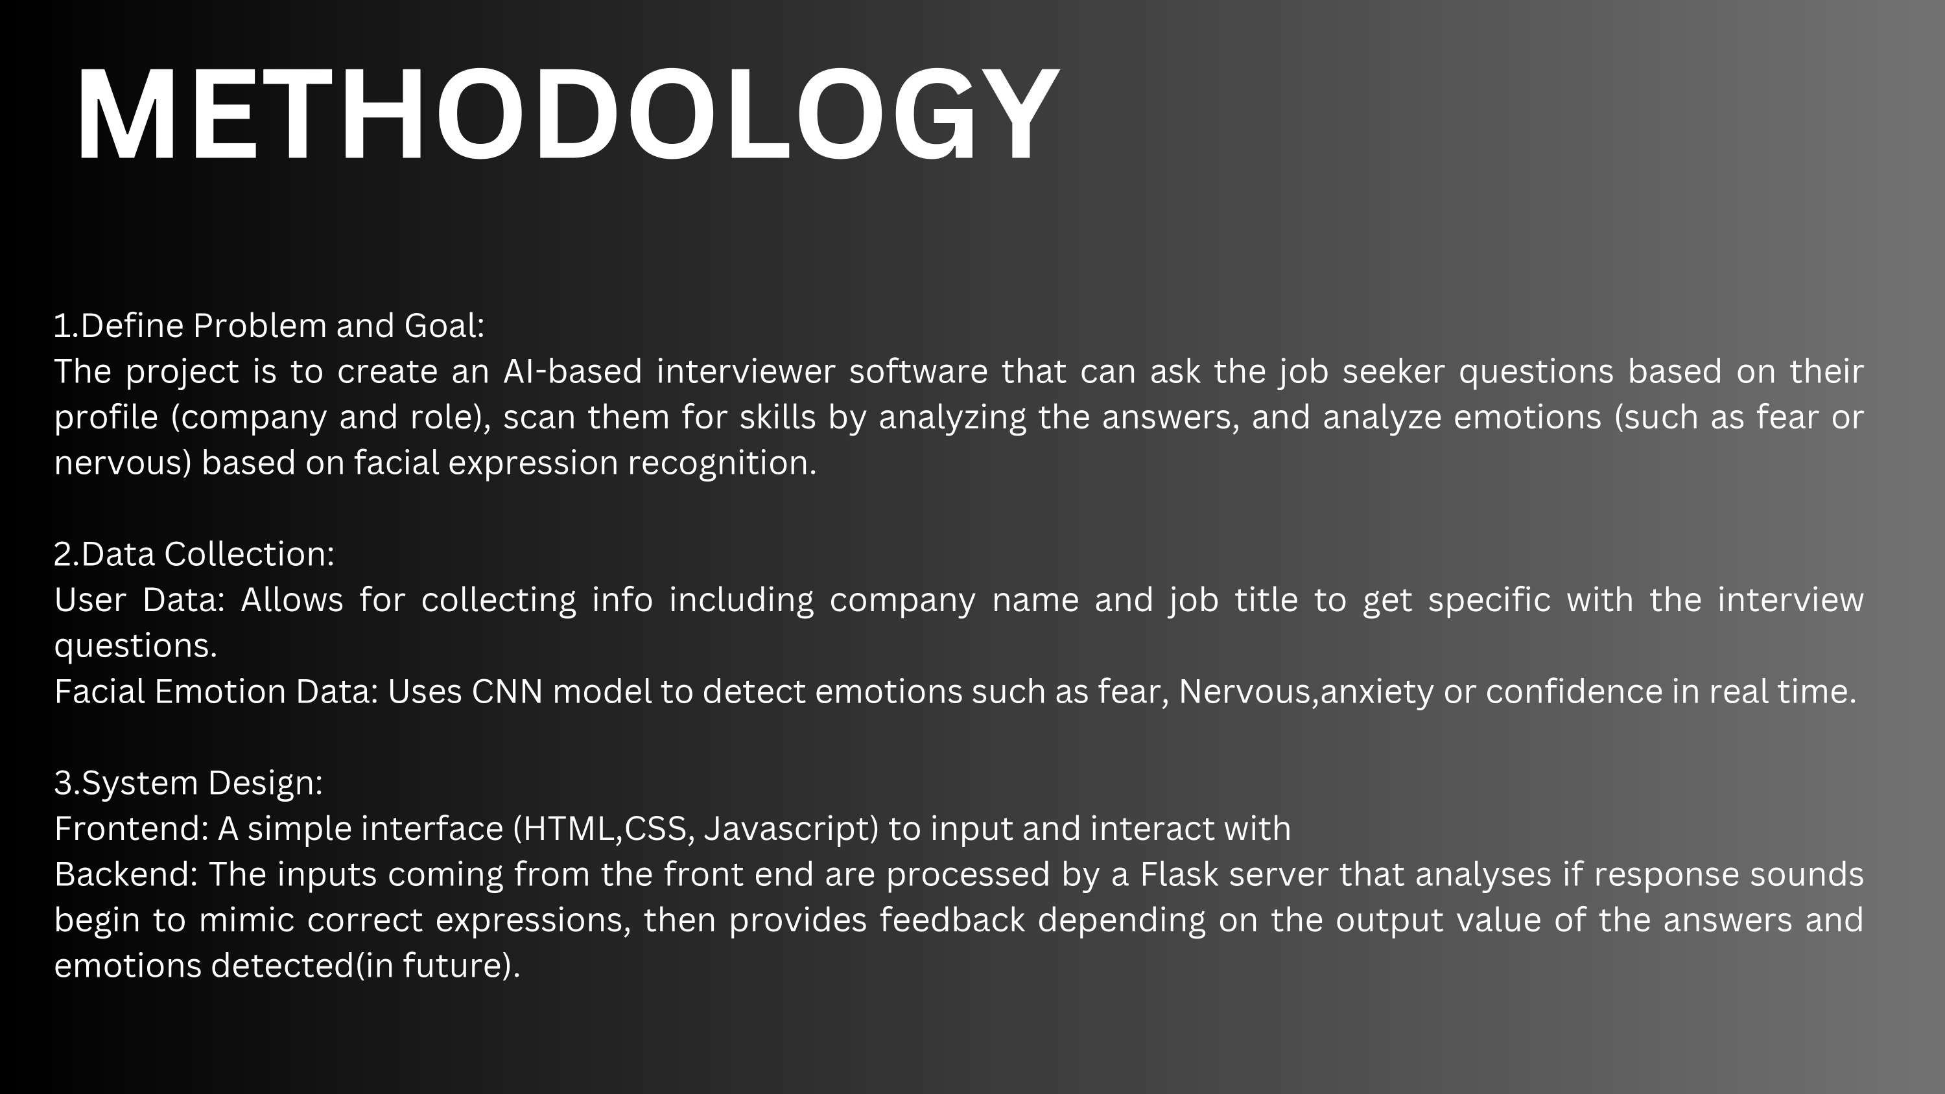

Slide 4
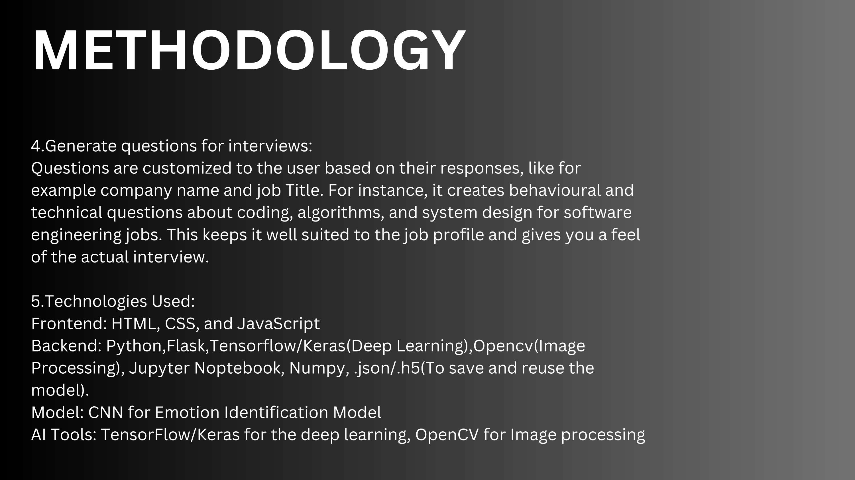

Slide 5


Slide 6


Slide 7
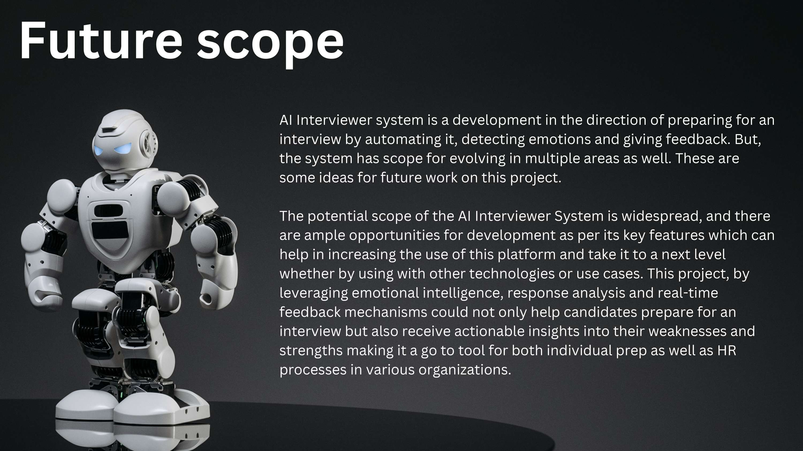

Slide 8
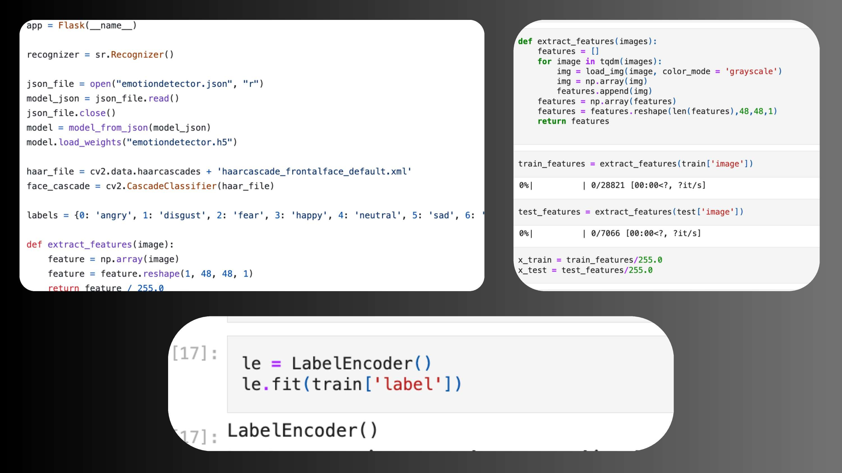

Slide 9
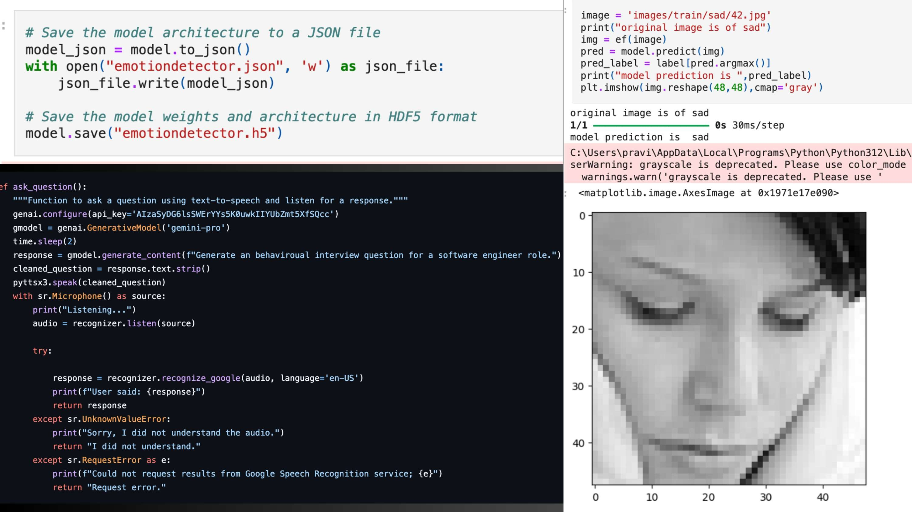

Slide 10

Praveen Lokku
E23CSEU0339
(Backend)
Coding | Developing
Deployment
Venkat Somnadh
E23CSEU0402
Research
Frountend deelopment
Diya Singh
FrountEnd Development
Designing
Ppt And presentation

Slide 11


